Slide 1
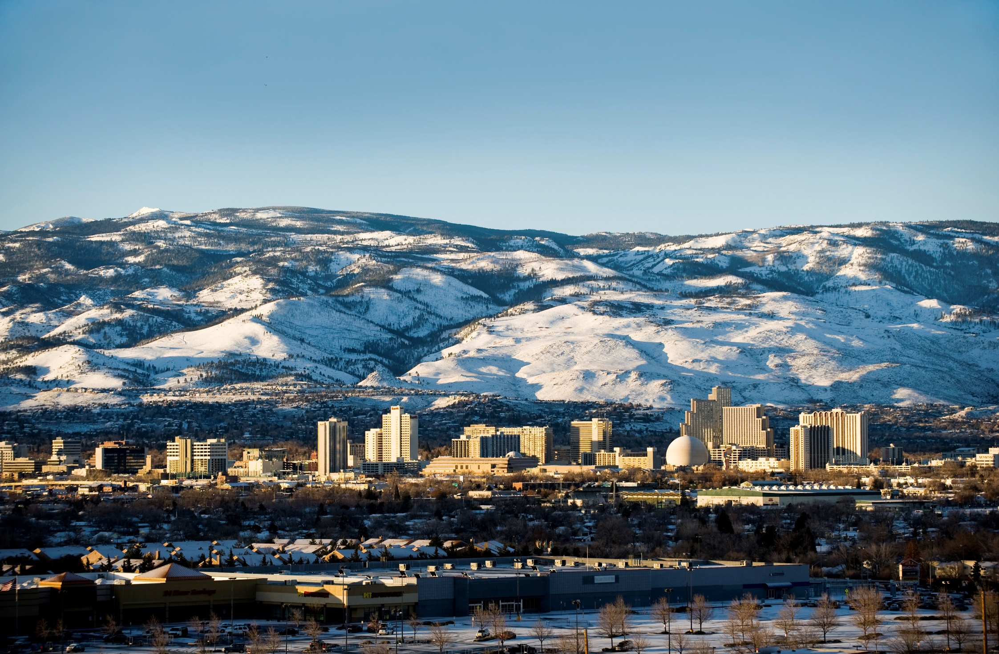
May 2019
RTC RIDE Service Improvement Recommendations
March 6, 2019

Slide 2
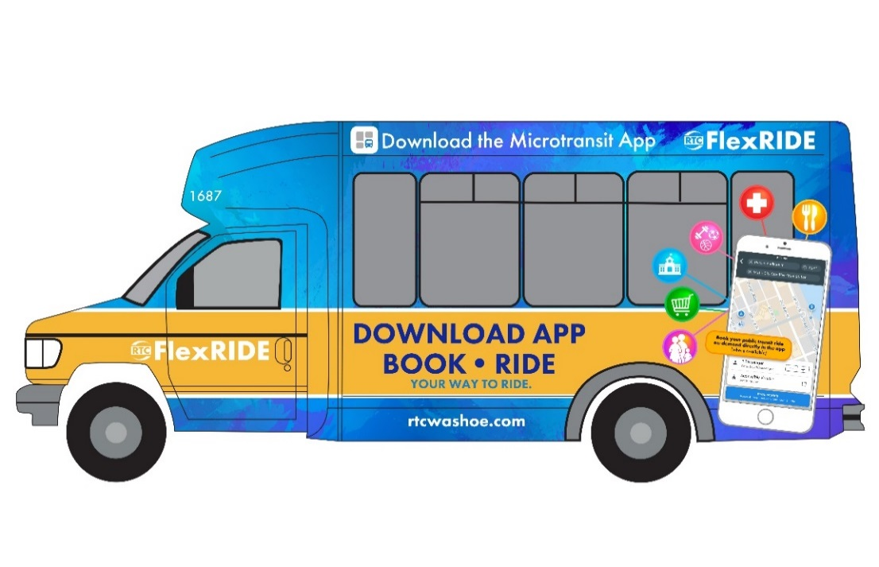
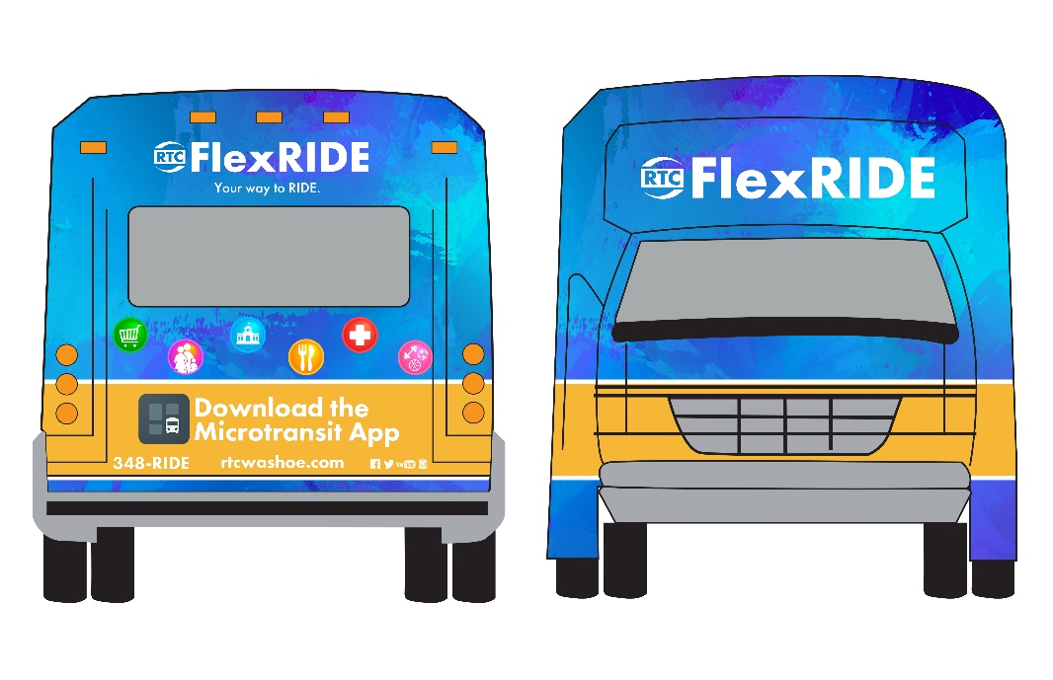
RTC RIDE Spring FY 2019 Service Improvements
Introducing Microtransit Pilot Program – RTC FlexRIDE
Proposed changes effective May 4, 2019

Slide 3
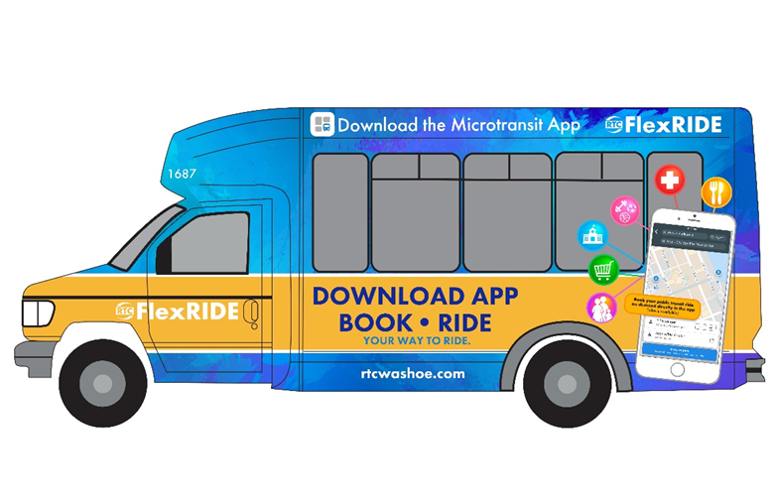
What is FlexRIDE and How it Works
Public transit version of Transportation Network Company (TNC) type services
TNC is a general name given to services like Uber or Lyft
Passenger hails a ride:
Rides within the microtransit service area
Rides into or out of the microtransit service area (by connecting to other RTC services at key connection points, below)
Rides are hailed using:
Smartphones with an app
Tablets with the app
Computer via a specific website
By a phone call to dispatch
Same Day Booking & Real-Time Information (e.g: van location)
Passengers provided curb-to-curb service within service area
Passengers connect with RTC RIDE or RTC ACCESS at key connection locations (Iron Horse Shopping Center & RTC Centennial Plaza)
Can call for a trip within 30-minutes of your expected departure time
Utilizes a smaller vehicles (similar to the RTC ACCESS)
12-passenger wheelchair equipped, bicycle rack equipped vans
Cheaper to operate
Cheaper to maintain
Can operate on more streets

Slide 4
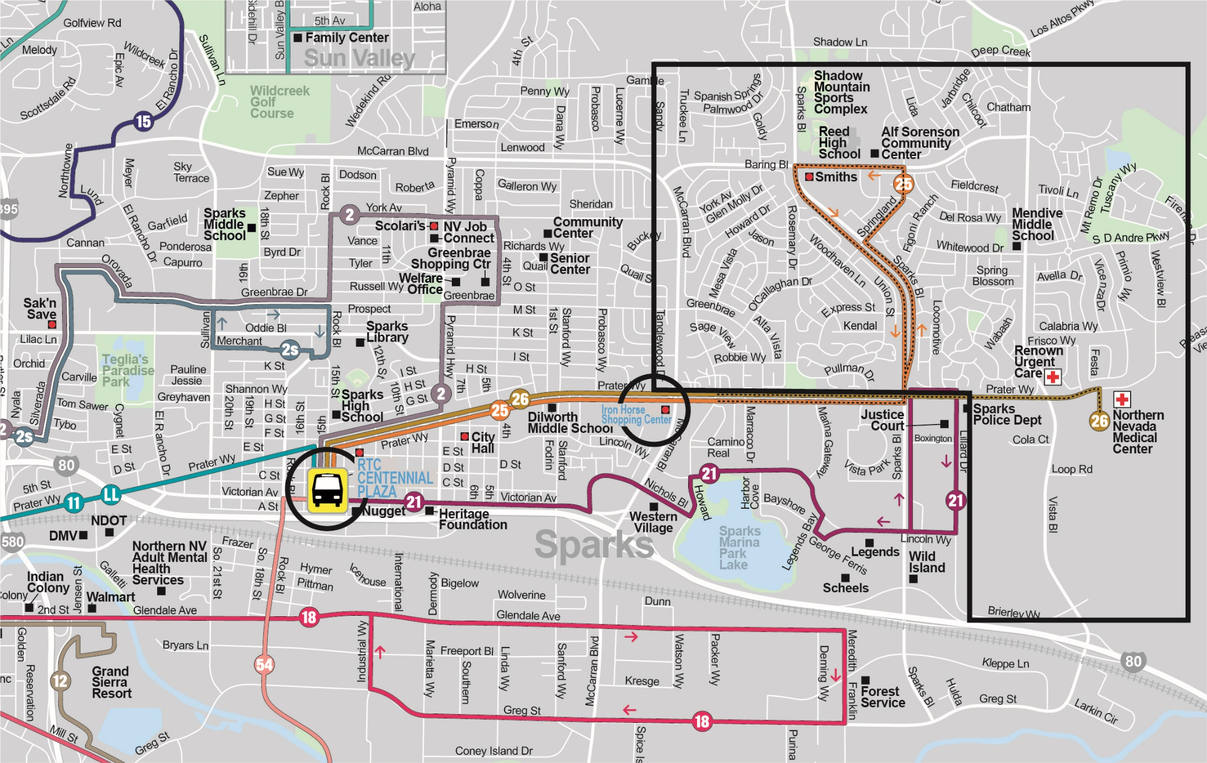

Slide 5
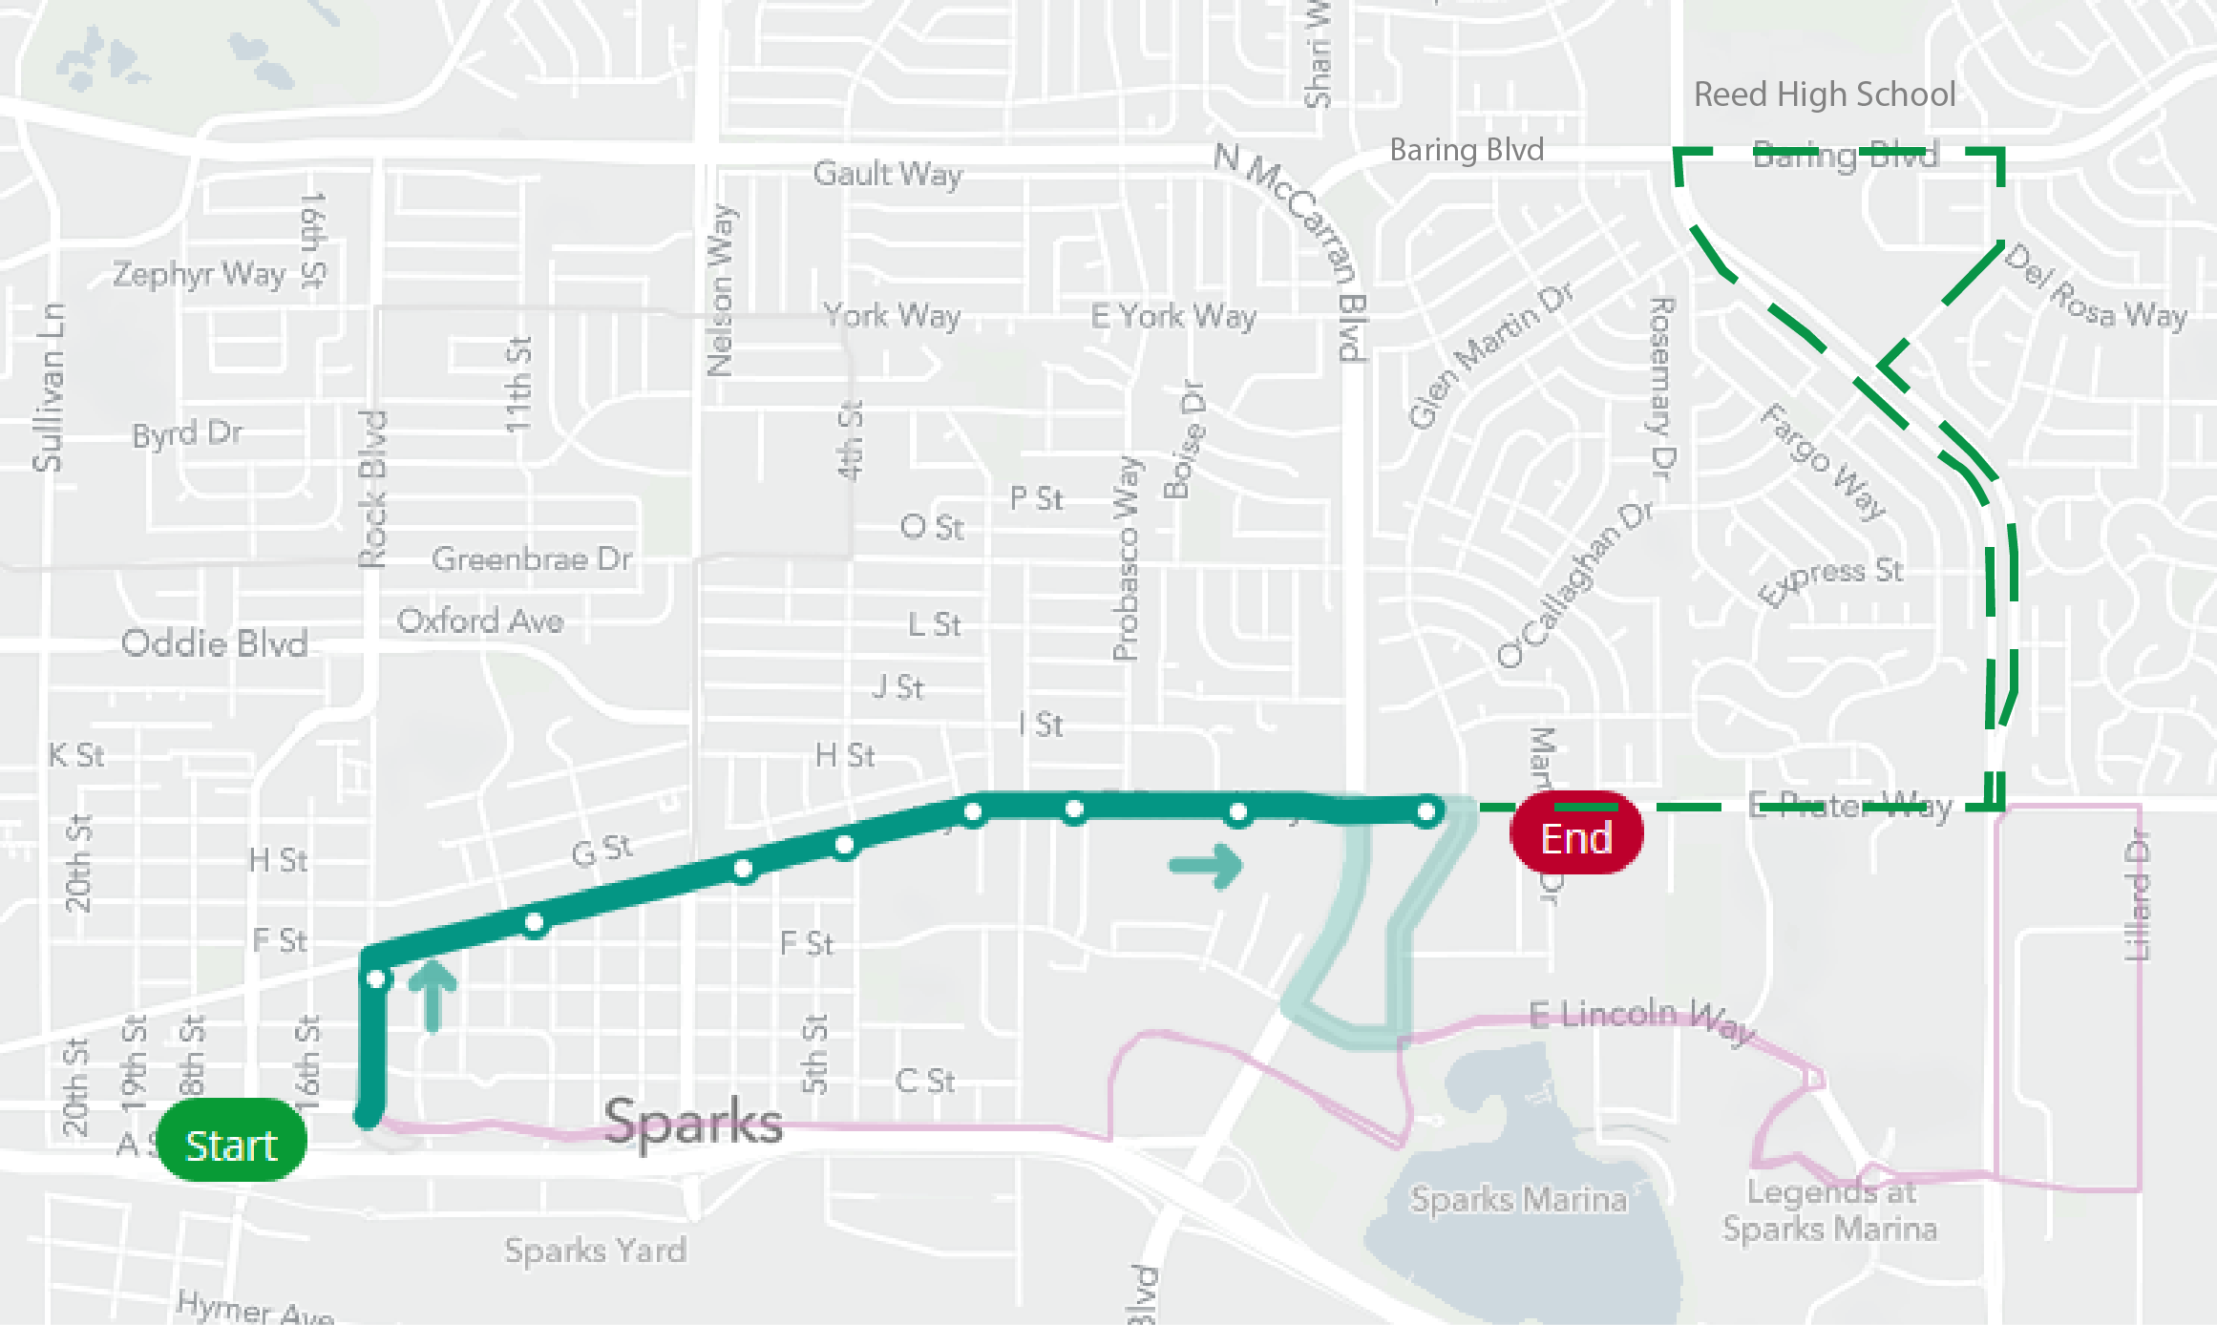
Proposed Change to Routes 25 – Line-of-Route

Slide 6
FlexRIDE Service Planning Process
RTC did an industry review for assistance in this new transit service platform
One consultant currently specializes in microtransit planning and operation for public agencies
RTC contracted with Transloc
RTC provided current ridership data to Transloc
Data included ridership by stop by time-of-day
RTC provided basic service area
Proposed service – North and East Downtown Sparks
RTC provided general service span
RTC provided main connection stops
Iron Horse Shopping Center
RTC CENTENNIAL PLAZA Station
Transloc models the service based on three ridership scenarios

Slide 7
FlexRIDE Service Planning Process Simulation Results
Three different scenario simulations run
Assume average 50 rides per day
Assume average 100 rides per day
Assume average 200 rides per day
50 rides per day results:
Average wait time all riders = 8 minutes
Average ride time all riders = 8 minutes
Possible extreme wait time = 15 minutes (5% of riders could experience)
Requires two vehicles
100 rides per day results:
Average wait time all riders = 10 minutes
Average ride time all riders = 10 minutes
Possible extreme wait time = 20 minutes (5% of riders could experience)
Requires two vehicles
200 rides per day results:
Average wait time all riders = 13 minutes
Average ride time all riders = 13 minutes
Possible extreme wait time = 30 minutes (5% of riders could experience)
Requires two vehicles
A 3rd vehicle can be added to the 100 and 200 scenarios, effect reduced efficiency

Slide 8
FlexRIDE Service Planning Process - Public Involvement
RTC Public Outreach
October 2018 service change public outreach
Transit Planner / Scheduler holds monthly meetings with riders each month
Recent survey of Route 25 and Route 26 passengers
October 2018 Service Change Outreach:
Concept introduced and discussed during these public outreach events held in 2018
January 2019:
Service Change Outreach – Two events 1st on 28th , 2nd on 29th
Transit Planner / Scheduler Monthly Passenger Contact:
Michael Dulude makes himself available at 4th STREET STATION
Provides an opportunity for customers to discussion planning and scheduling challenges and opportunities
Microtransit is usually discussed as a transit option
Have announced the pilot program could start Spring 2019
Routes 25 and 26 Survey:
Staff performed a survey of riders
Staff explained to those who wanted to know more
Only 9% of current customers were unfavorable towards microtransit
77% of current customers carried a smartphone

Slide 9
Questions?
Michael Dulude, Public Transportation
Transit Planner / Scheduler
mdulude@rtcwashoe.com
(775) 335-1904
This is Your RTC.

Slide 10
FlexRIDE Service Planning Process - Agency Visit SmaRT RIDE Service Details
Sacramento Regional Transportation District Visit:
September 2018 visit
February 12, 2018 Microtransit service implementation – initial area of 16.6 sq. miles
Ridership exceeds 150 riders per day
Based service on the 100 riders per day scenario
Started with 4 buses
April 23, 2018 Orangevale Expansion – 21 sq. miles
Expanded to 8 buses
riders per day exceeded 250
July 30 2018 – launched new service area
Today, passengers per day exceeds 350 on the average
Scheduling app tends to do most the work
SmaRT Ride passengers per revenue currently exceed Old CityRide (2.25) at 3.85 avg.
Basic Fare is $2.50
Citrus Heights service area – 49% app vs. 51% Call-in
Franklin Blvd. – South Sac area – 63% vs. 37% Call-in

Slide 11
FlexRIDE Service Planning Process Continued
Transloc provides simulation of potential ridership
Which provides scenarios based on number of vehicles
Simulation model input data also included:
Simulated ride request demand by time of day

Slide 12
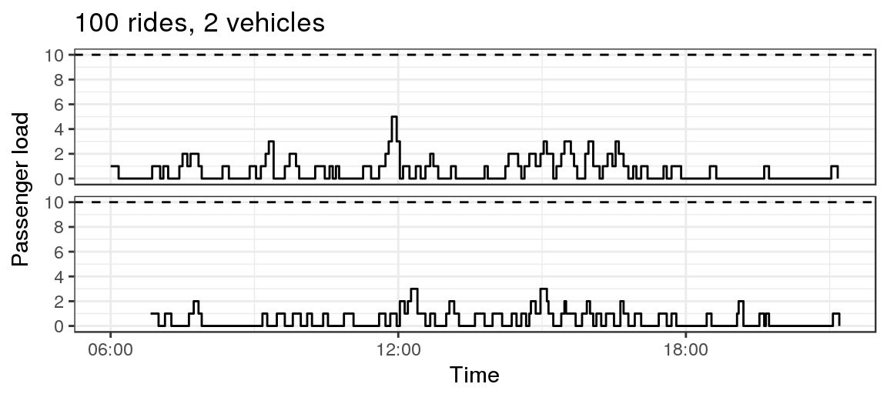
FlexRIDE Service Planning Process Simulation Results
Best Scenario Option for Sparks Service Area:
Most realistic option at start-up is the 100 rides per day with two vehicles
Simulation potential passenger load:
Vehicle 1
Vehicle 2
The horizontal dashed line shows the simulated vehicle capacity.

Slide 13
FlexRIDE Service Planning Process – SmaRT RIDE Pilot Take-Aways
Sacramento Regional Transportation District Visit:
Avg Daily Trip Requests: 150
Avg Daily Passenger Boardings: 143
Avg Daily Completed Rides: 122
Ride Sharing Rate: 29%
Uniquely Identified Riders: 1,200
Two-thirds of whom took more than one trip and 46% of whom have been retained over the lifetime of the pilot
48% of riders use the service every week and 6% use it every day
8% of riders used a mobility device that required the use of the lift
Rider Experience per Day Average
Wait time: 16 mins (41 mins)
Ride duration: 14 mins (31 mins)
Total trip (wait + ride): 30 mins (62 mins)
(95%iles indicate that 95% of rides had a time less than this value)

Slide 14
FlexRIDE Service Planning Process - Lessons Learned from SmaRT RIDE
Sacramento Regional Transportation District Visit – Lessons Learned:
Rapid ridership growth
Software improvements (app, desktop, dispatch)
Balancing trip wait times and available resources
Service zone right size-ing
First mile/last mile connections
Wheelchair accessibility a plus
Safety and Security benefits over TNC’s
Marketing and community outreach
Customer communication enhancements

